Slide 1

Adaptive Lighting & Window System
Autonomous IoT Environmental Control & 3D Digital Twin Integration
Anas Hatem Mahdali | 239045
The British University in Egypt | Industrial Internet of Things | 25MTRN04H

Slide 2
The Cost of Energy Waste
12.05
Inefficient Resource Management
Average households lose significant energy due to forgotten lighting and ventilation. This project leverages the ESP32 to bridge the gap between occupant behavior and environmental efficiency.
kWh Wasted Per Home/Year

Slide 3





System Objectives
Autonomy
Safety
Transparency
Intelligent control of lighting and windows based on real-time sensory perception.
Prioritizing human life through advanced gas leak detection and automated ventilation.
Real-time telemetry mirrored through 2D cloud dashboards and 3D digital twins.

Slide 4
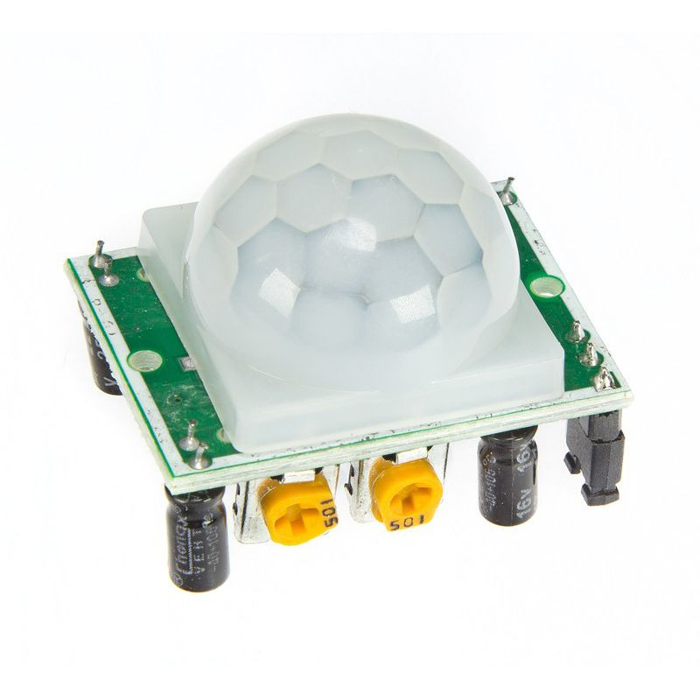
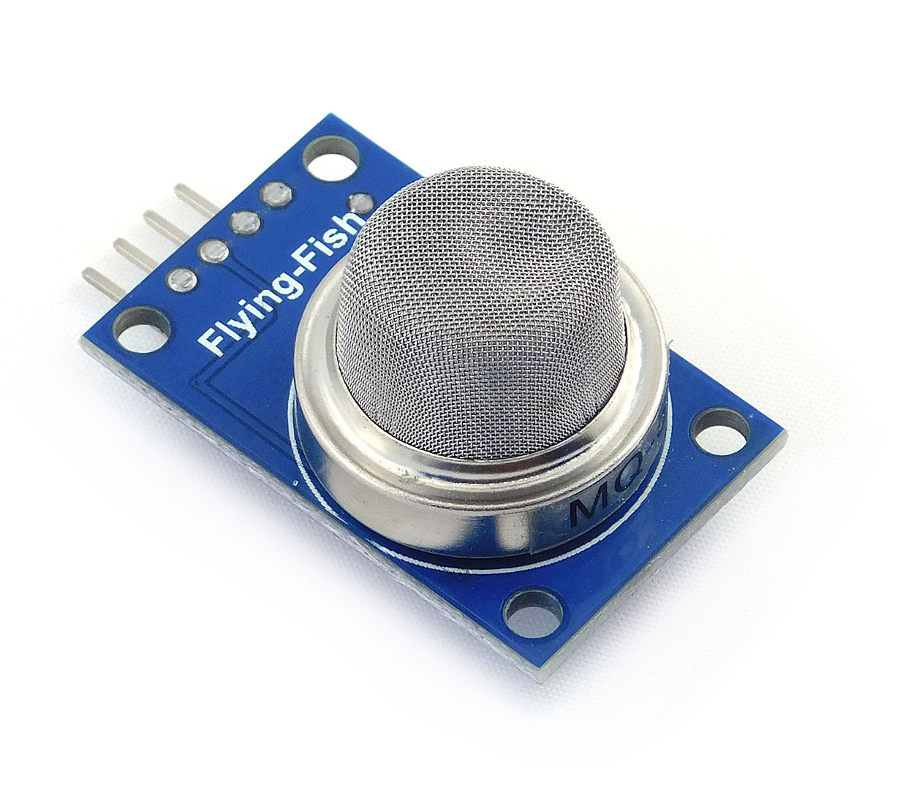
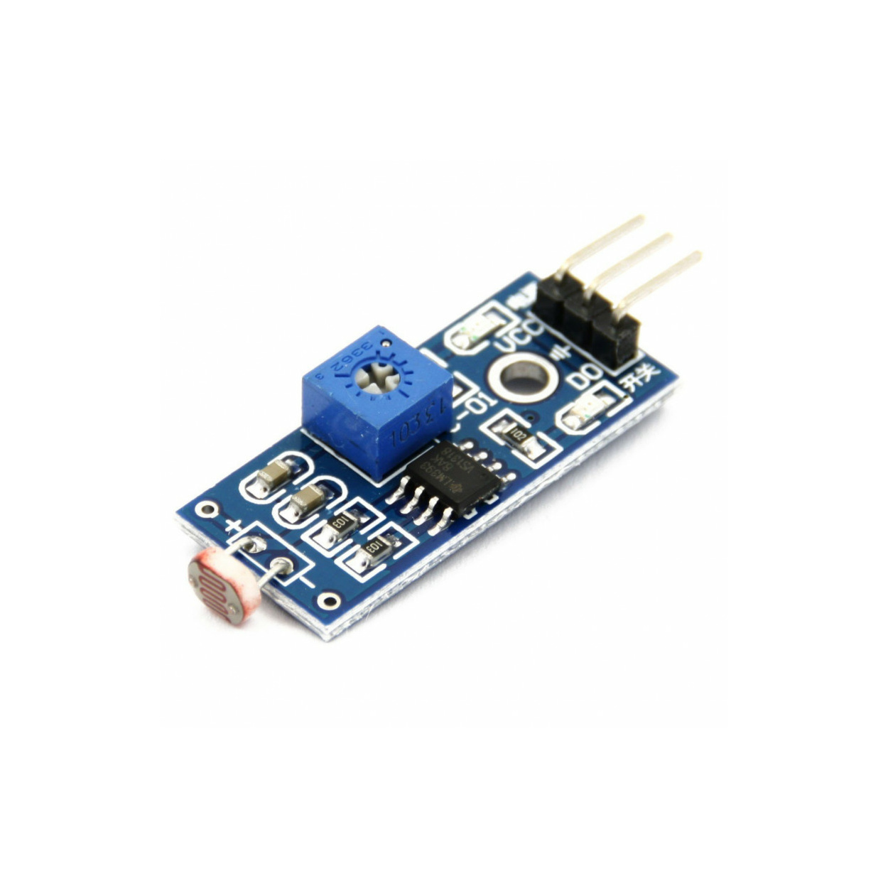
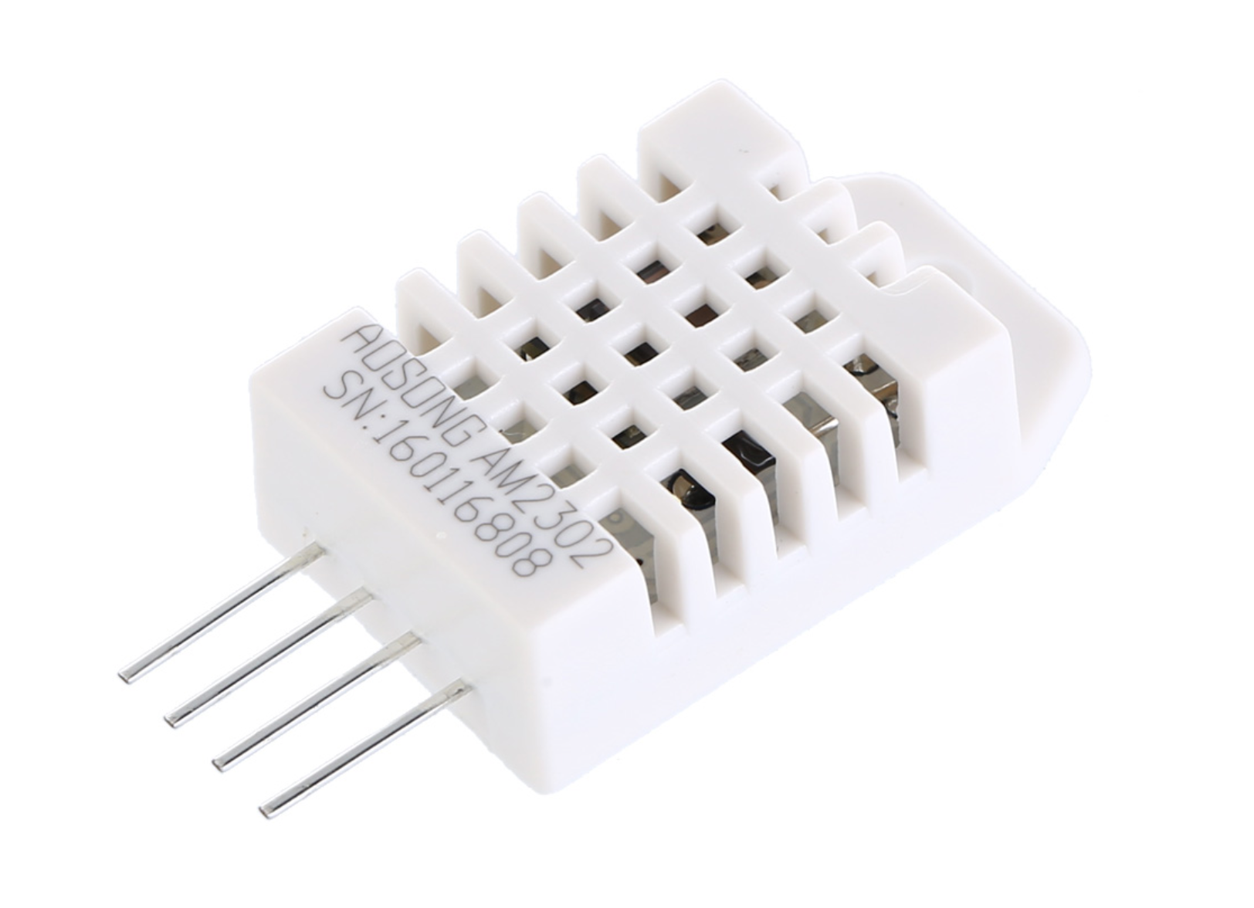
Perception Layer: Sensors
DHT22: High-precision temperature and humidity tracking.
LDR 1 & 2: Mapping interior vs. exterior ambient light intensity.
PIR Sensor: Passive Infrared detection for motion-based lighting.
MQ5 Sensor: Critical detection for combustible gases (LPG/Methane).

Slide 5
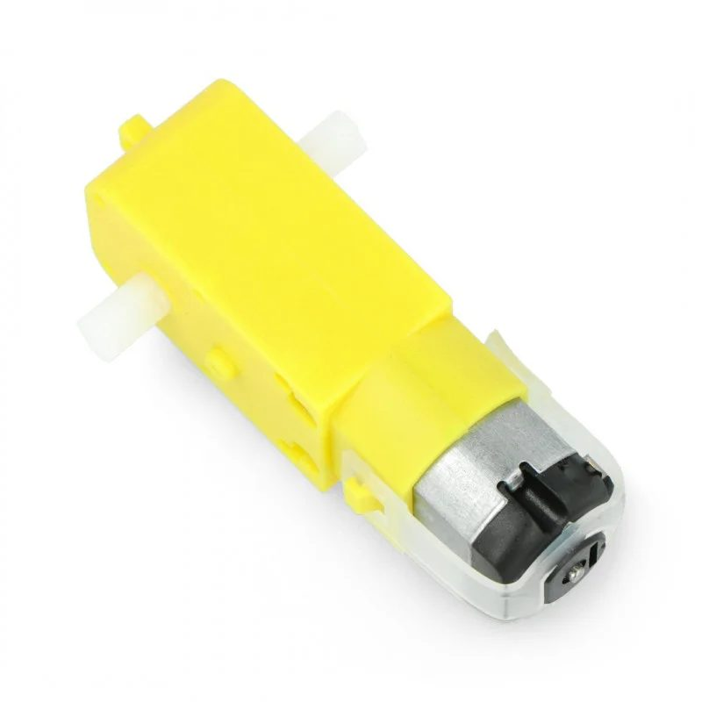
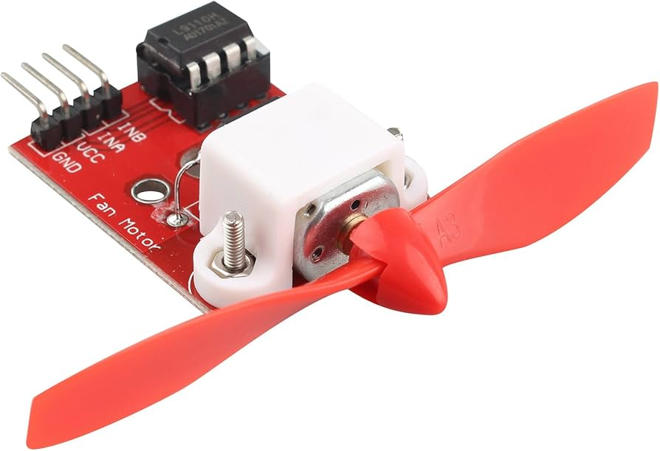
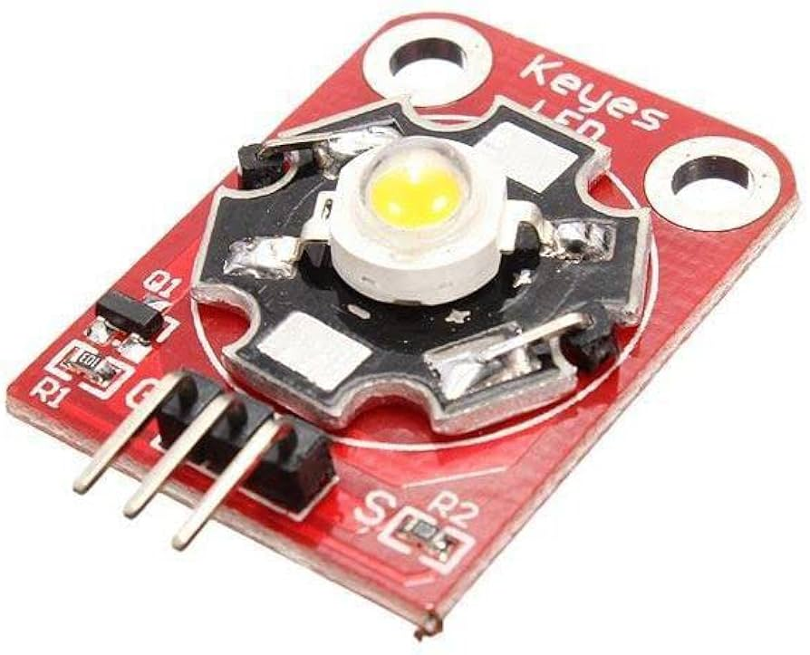
Action Layer: Actuators
Motion Controls
Active Ventilation
Smart Lighting
Window and curtain sliding mechanisms driven by L298N drivers with precisely timed pulses.
L9110 Fan Module used for rapid room cooling and toxic gas expulsion.
High-efficiency 3W LED Module providing 200 lumens of occupancy-based illumination.

Slide 6
State Management Hierarchy
Tier 1: Absolute Failsafe: High-priority emergency protocol that overrides all local and remote inputs during gas detection.
Tier 2: Automated Mode: Intelligent regulation using thermal thresholds (>30°C) and light intensity (>2000 lux).
Tier 3: Manual Override: Direct cloud-based control via MQTT topics, granting user agency over specific actuators.

Slide 7


Emergency Protocol
Trigger: 60% Gas
Release: 40% Gas
Upon detecting combustible gas levels exceeding 60%, the system initiates a total lockout, forcing windows and curtains open while engaging full-power ventilation.
To prevent motor stuttering from sensor jitter, the "Hysteresis" logic only releases control once levels drop safely below 40%.

Slide 8
Network Architecture
Multi-Pipeline Telemetry for Scalable IoT Performance

Slide 9
Data Pipelines
Pipeline | Technology | Purpose | Update Rate
Real-Time Monitoring | Ubidots MQTT | 2D Dashboards & Remote Toggles | 5.0 Seconds
Historical Storage | GCP BigQuery | Long-term Data Analysis | 60 Seconds
Digital Twin | WebSockets (WS) | 3D Visualization & Low Latency | 2.0 Seconds

Slide 10
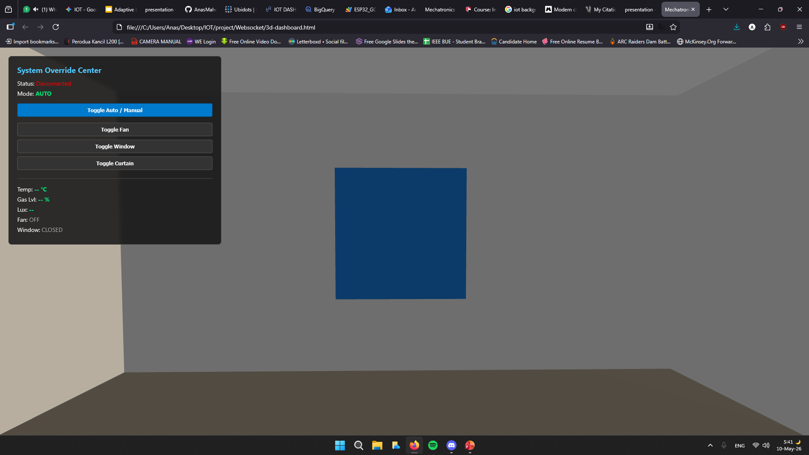
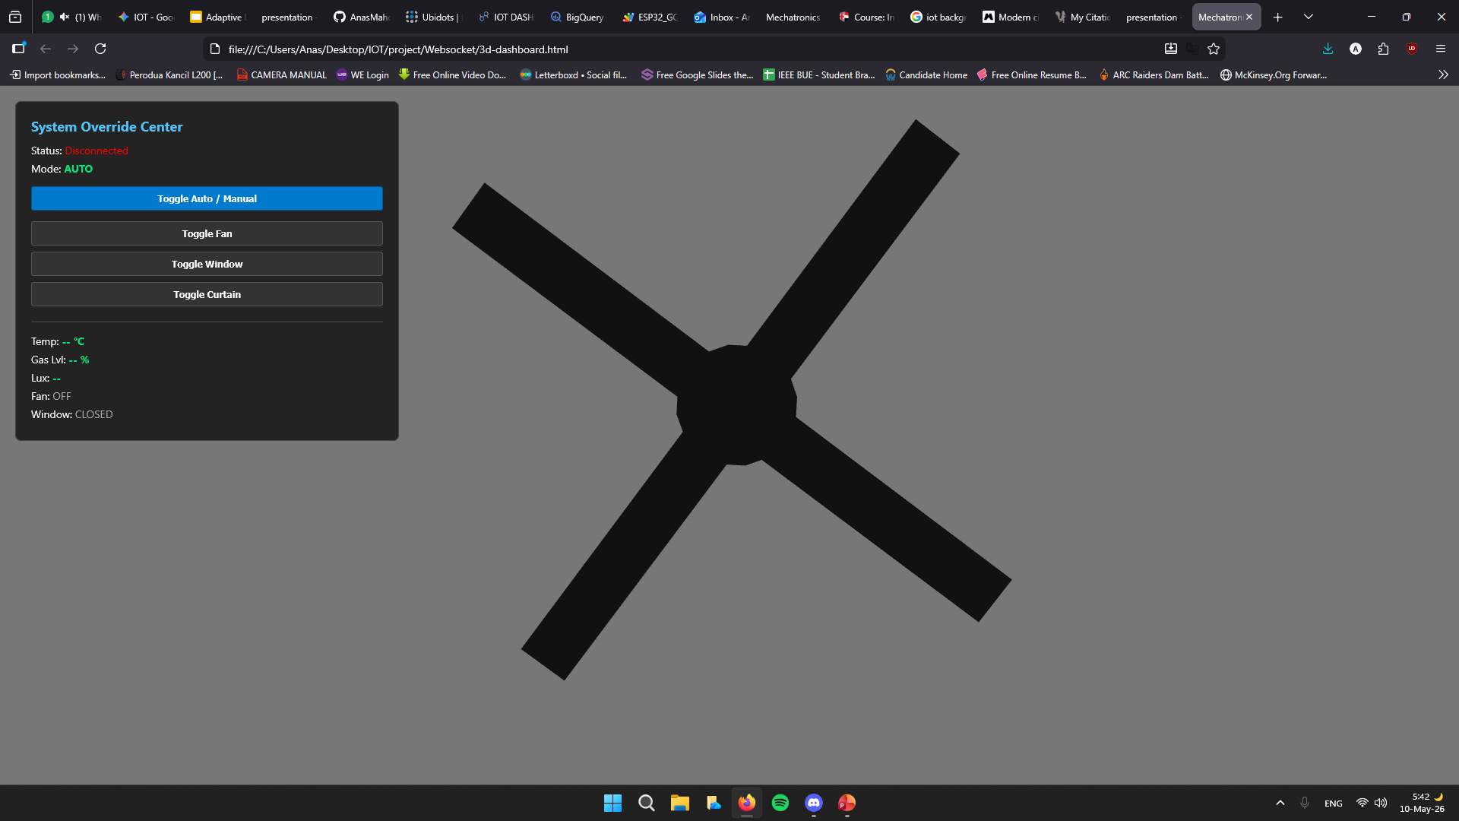
3D Digital Twin
Visual Mirroring
Built with Three.js and WebGL, the system features a 1:1 virtual replica of the physical environment. Actuators like fans and windows are animated in real-time to match physical motor timers.
Dynamic landscape textures swap based on LDR light data to simulate actual time-of-day environments.

Slide 11
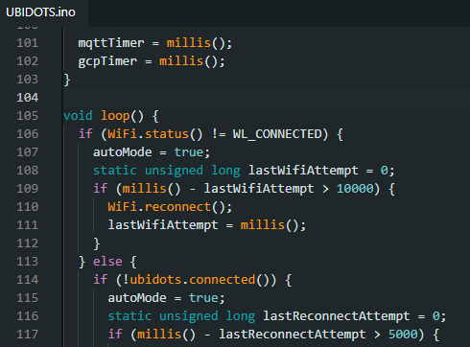
Engineering Robustness
Offline Resilience
The system actively monitors Wi-Fi and MQTT links. If a connection failure is detected, the ESP32 automatically defaults to "Local Auto Mode," ensuring environmental stability without cloud commands.
Power Isolation
Logic (3.3V/5V) is strictly isolated from load (9V/12V). Independent power supplies for motor drivers prevent brownouts during simultaneous actuator engagement.

Slide 12

Conclusion
Feasible low-cost microcontroller integration with high-fidelity 3D cloud telemetry.
Any Questions?
anas239045@bue.edu.eg

